Slide 1
3-Player Kuhn Poker Final Project
Juan Lopez

Slide 2
Agent Approach
Implemented Nash equilibrium first subfamily values, calculated by Szafron et al.
The authors determined that the best worst-case payoff strategy when playing against agents using different equilibrium profiles is to choose a strategy where:
B11 = B21
C11 = 0

Slide 3
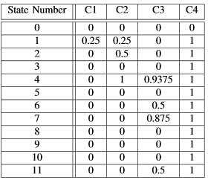
Agent Approach

Slide 4
Other Approaches
Tried the idea of dynamically changing our agent's selected subfamily based on its performance against the other players.
Defined a learning phase based on the first 900 games and allocated 300 games to each subfamily
Recorded total payoff for each subfamily
Picked the family with the highest payoff and played the remaining 2100 games using the parameter values from this equilibrium profile

Slide 5
Other Approaches
However, during our testing, this approach resulted in a lower average payoff than simply using subfamily 1 throughout the entire game
Did not incorporate this approach into our final agent.

Slide 6
Other Approaches
Tried to calculate the average payoff after taking a particular action. We used this information to change the probability of taking a particular action in a subsequent game.
At each decision point, our agent could take one of two actions, defined as action 0 or action 1 for the aggressive and passive actions, respectively.
Created a 3-d array, which uses the card number, state number, and action number. In this array, we stored the average payoff that our agent earned playing the action.

Slide 7
Other Approaches
Tried to calculate the average payoff after taking a particular action. We used this information to change the probability of taking a particular action in a subsequent game.
At each decision point, our agent could take one of two actions, defined as action 0 or action 1 for the aggressive and passive actions, respectively.
Created a utilities 3-d array, which uses the card number, state number, and action number. In this array, we stored the average payoff that our agent earned playing the action.
Update table after every game

Slide 8
Other Approaches
Used the first 2000 games as a training period.
After the first 2000 games, we retrieved the average payoffs from the table for the two possible actions for a given state.
We then averaged this probability with the existing probability for this state from the table, and we set the new value in the table.

Slide 9
Other Approaches
Learning agent had worse performance than our original agent

